Slide 1

DEVS MAY CRY
Angela Novoa Ramos
Lilia Khabarova

Slide 2

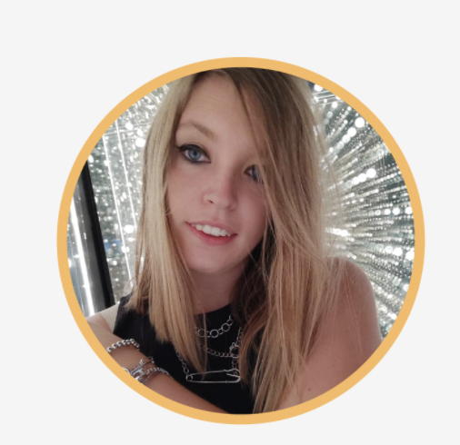
Who are we?

Slide 3
What is Tymit?
https://apply.workable.com/tymit/

Slide 4
Step by step
QA
Differents types of testing
QA and SDLC
Friend or enemy?
Manual vs automation
Quiz y candies
Need more info?

Slide 5
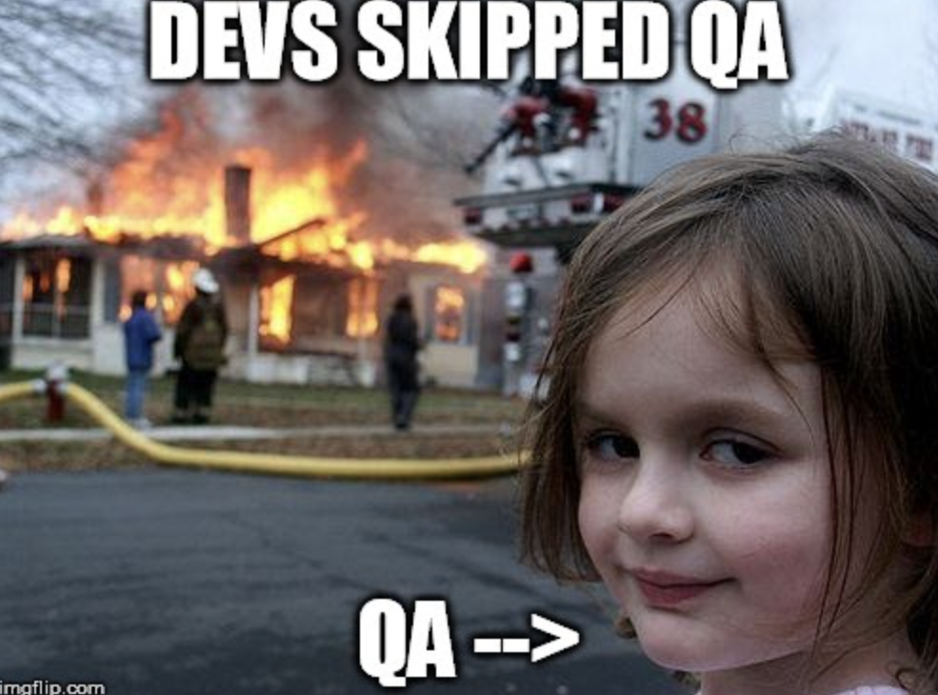
QA

Slide 6
Different types of testing
Smoke testing
Regression testing
Acceptance testing
End-to-end test
Functional test
Integration test
Unit test
Performance testing

Slide 7
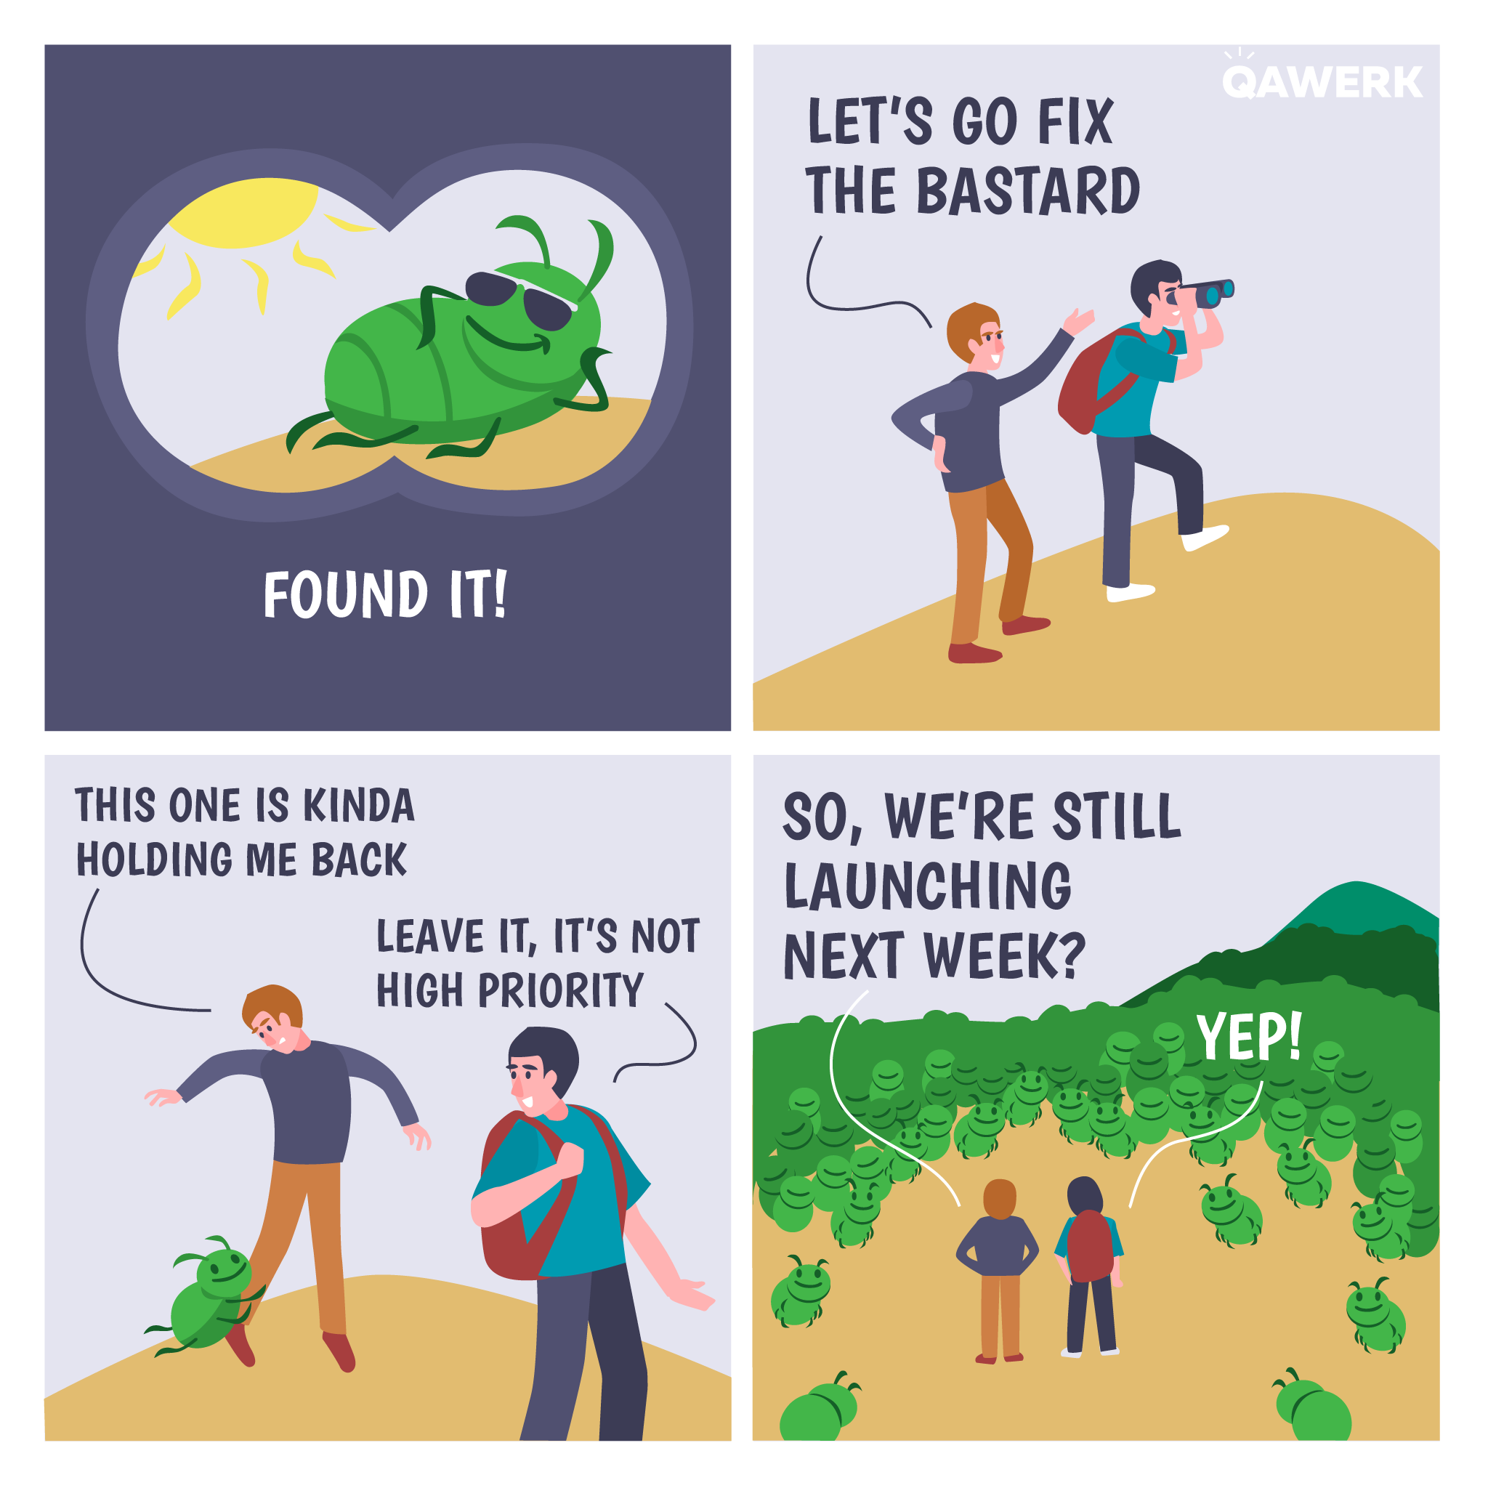
Test plans, test cases

Slide 8
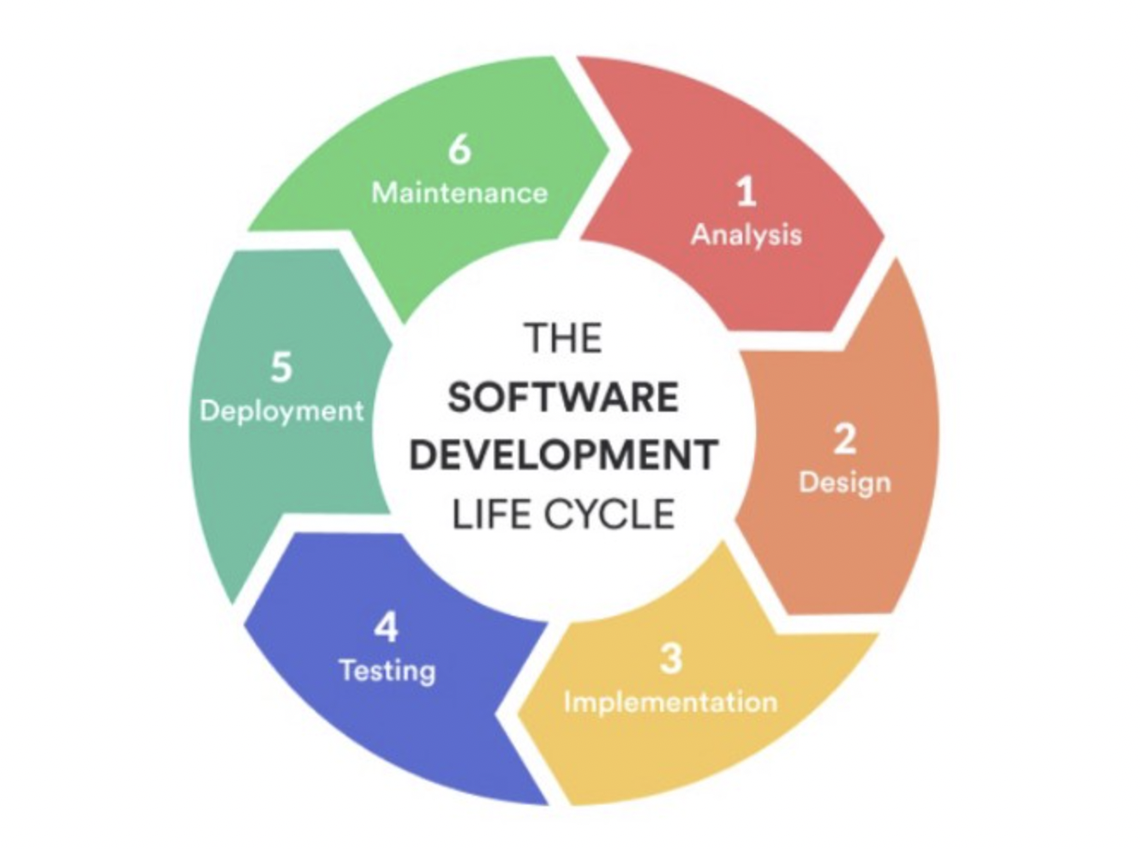
QA y SDLC

Slide 9
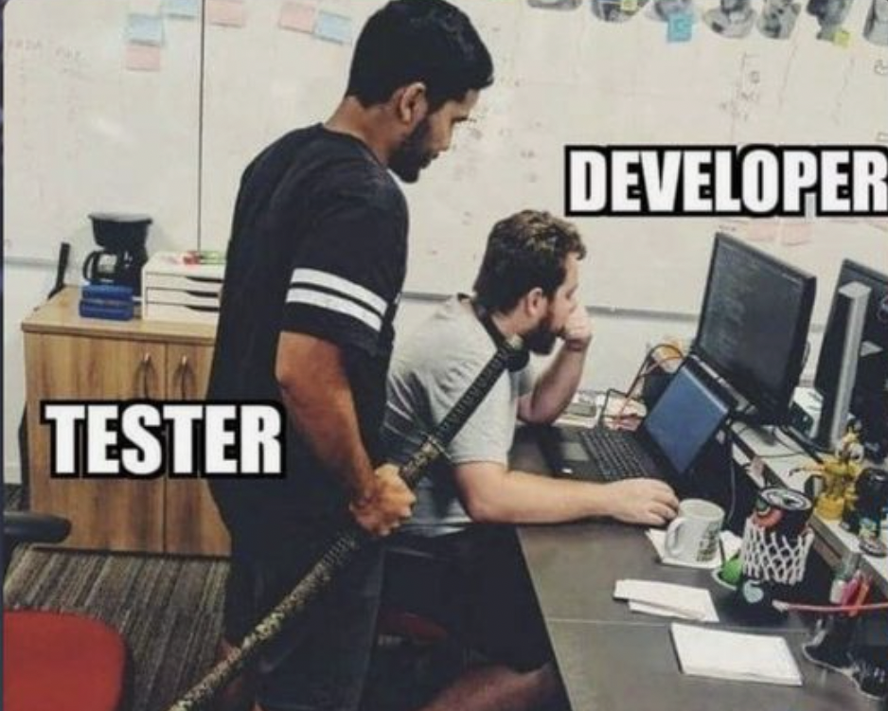
Enemy or friend?

Slide 10
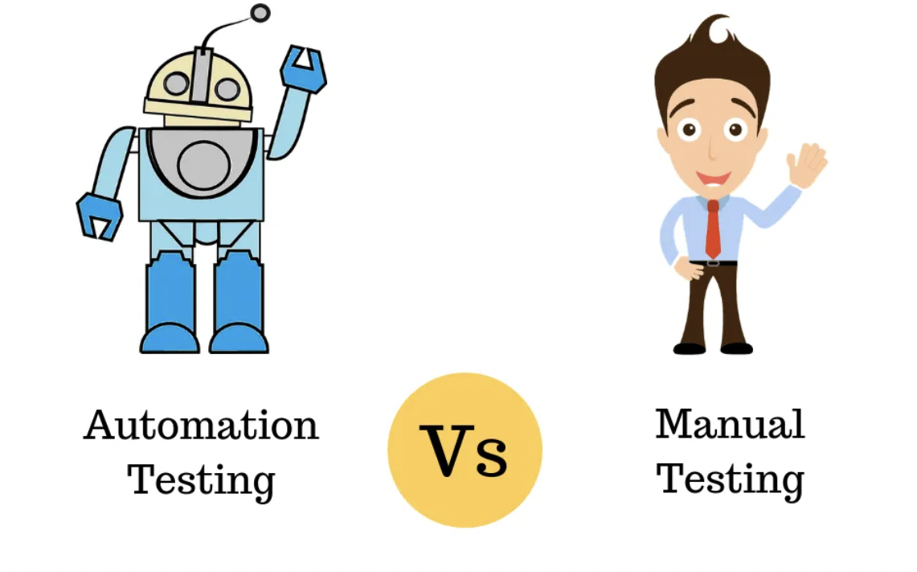
Manual vs automation

Slide 11
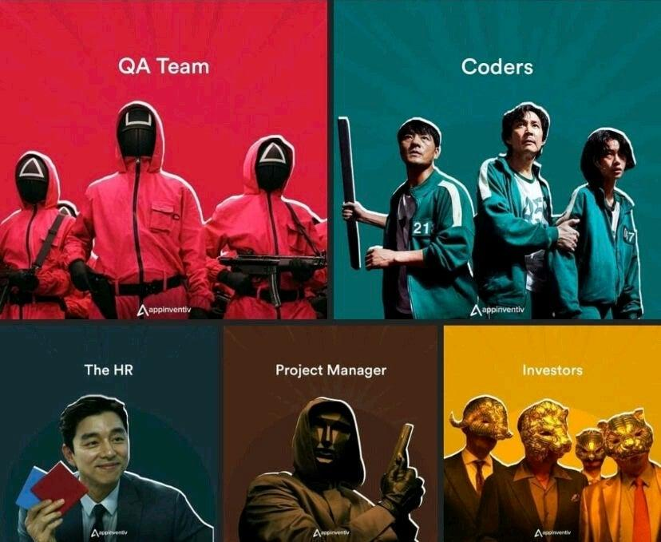
Quiz and candies

Slide 12
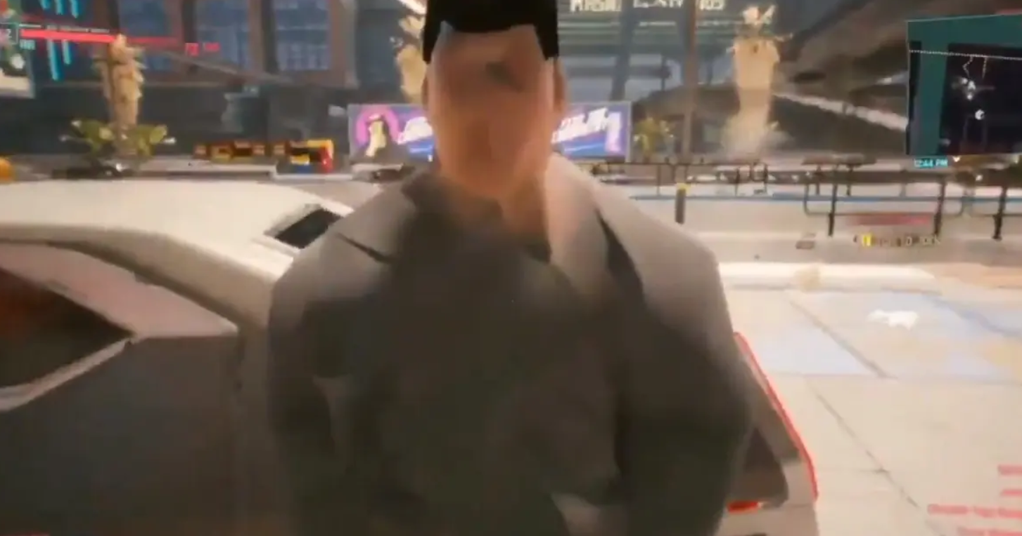
What is the problem with this image?

Slide 13
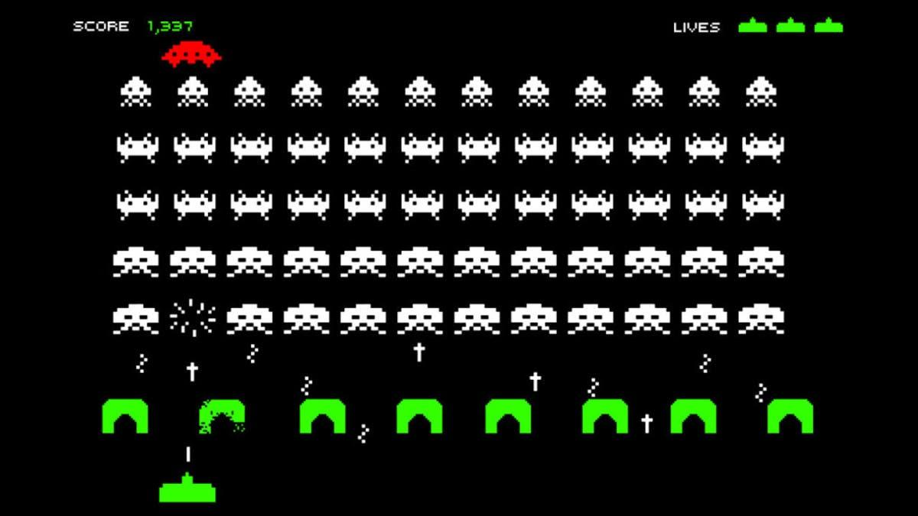
Bug or feature? Why the game it’s slower every time you kill one?

Slide 14

Something weird in the image?

Slide 15
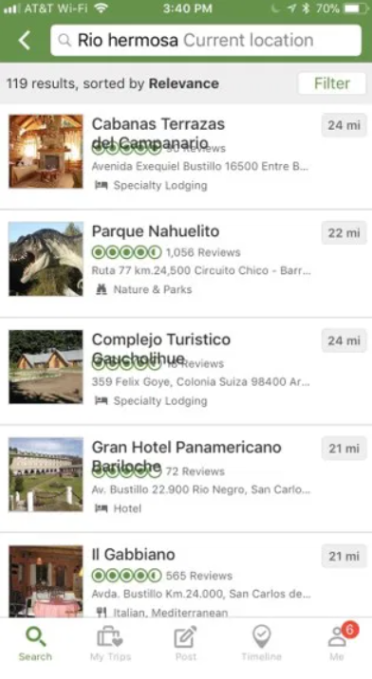
Is this a bug?

Slide 16
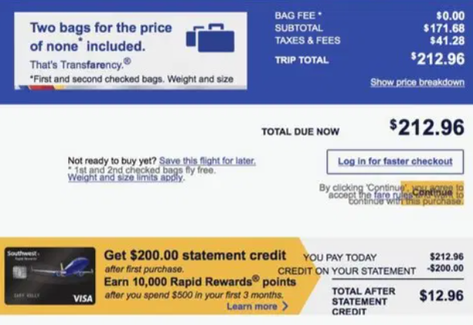
And here?

Slide 17
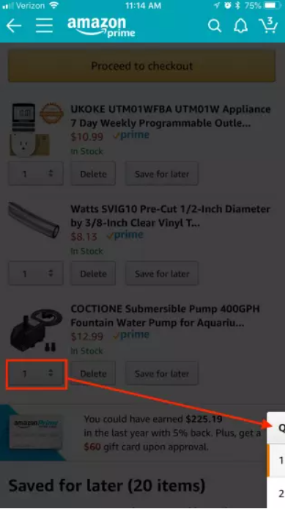
Amazon also fails sometimes

Slide 18
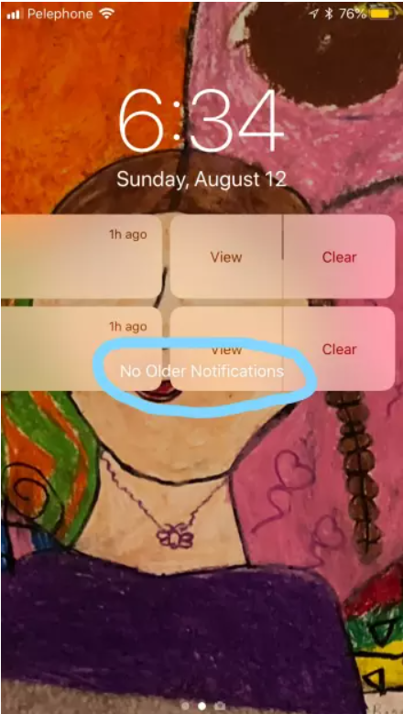
iOS, any problem?

Slide 19
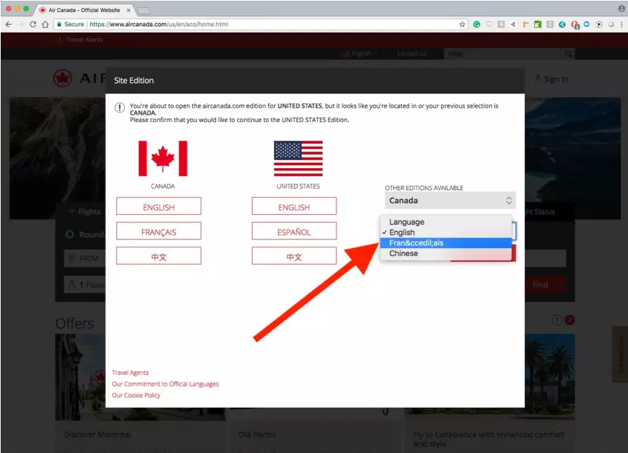
How do we get to this?

Slide 20
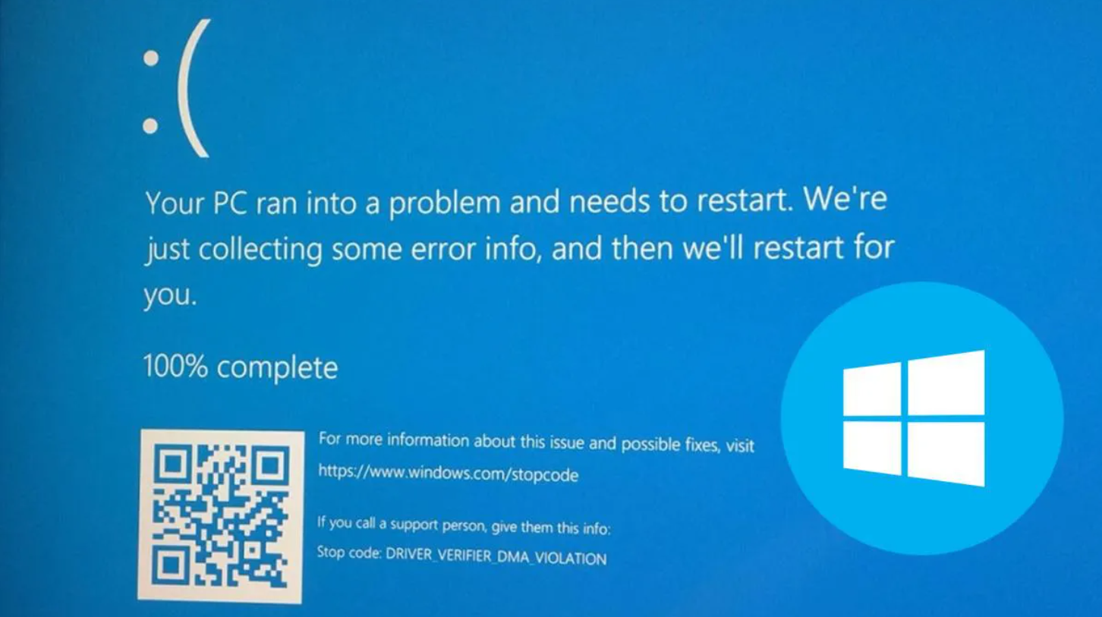
Blue scren

Slide 21
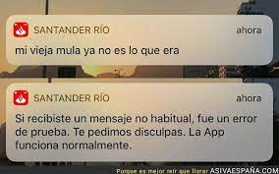
Santander...

Slide 22
Are you still interested?
International Software Testing Certification Board - https://www.istqb.org/
Udemy
Coursera

